Slide 1
Solving Third Degree Polynomial Equations
Michel Beaudin, michel.beaudin@etsmtl.ca
Frédérick Henri, frederick.henri@etsmtl.ca
École de technologie supérieure, Montréal, Québec, Canada

Slide 2
Abstract
Starting with some concrete examples, we use TI-Nspire CX CAS to solve third degree polynomial equations with real coefficients. Then we compare the answers obtained to the ones provided by other CAS.
Using Cardano’s method or François Viète’s formulas, we create a homemade function allowing Nspire to produce clear and compact answers for the solutions of a third degree polynomial equation: "Everything should be made as simple as possible, but not simpler".

Slide 3
Table of contents
Two examples showing CAS imperfections
An algorithm to beautify the solutions
Using TI-Nspire CX CAS
Conclusion

Slide 4
Two examples showing CAS imperfections – first example
Consider the following third degree polynomial function
$$f_{1}\left(x\right)=x^{3}+3x+1$$
Since :
a. the derivative of the function is strictly positive ;
b. $f_{1}\left(−1\right)=−3$ and $f_{1}\left(0\right)=1$ ;
we infer that the function has a single real root located between $−1$ and $0$.
Let’s look at the graph of the function to confirm this.

Slide 5
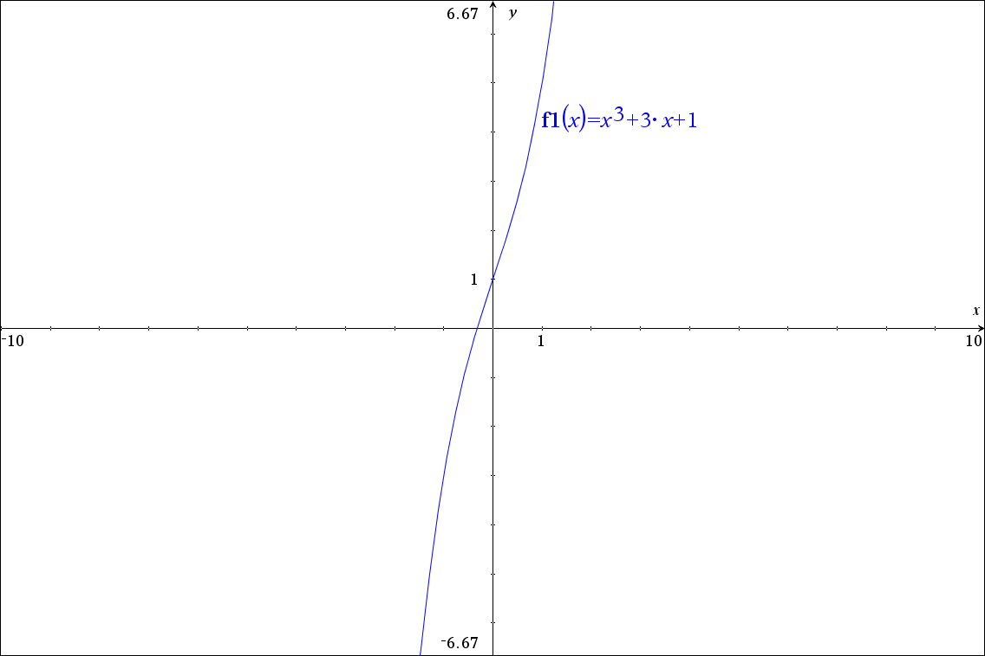
Two examples showing CAS imperfections – first example

Slide 6
Two examples showing CAS imperfections – first example
Let’s compare the solutions we obtain when we solve the equation
$$f_{1}\left(x\right)=x^{3}+3x+1=0$$
using 4 different CAS:
MapleTM,
MathematicaTM,
TI-NspireTM and
DeriveTM.

Slide 7
Two examples showing CAS imperfections – first example
With MapleTM:
$$−\frac{1}{2}{\left(4+4\sqrt{5}\right)}^{1/3}+\frac{2}{{\left(4+4\sqrt{5}\right)}^{1/3}}$$
$$\frac{1}{4}{\left(4+4\sqrt{5}\right)}^{1/3}−\frac{1}{{\left(4+4\sqrt{5}\right)}^{1/3}}+\frac{1}{2}\text{I}\sqrt{3}\left(−\frac{1}{2}{\left(4+4\sqrt{5}\right)}^{1/3}−\frac{2}{{\left(4+4\sqrt{5}\right)}^{1/3}}\right)$$
$$\frac{1}{4}{\left(4+4\sqrt{5}\right)}^{1/3}−\frac{1}{{\left(4+4\sqrt{5}\right)}^{1/3}}−\frac{1}{2}\text{I}\sqrt{3}\left(−\frac{1}{2}{\left(4+4\sqrt{5}\right)}^{1/3}−\frac{2}{{\left(4+4\sqrt{5}\right)}^{1/3}}\right)$$

Slide 8
Two examples showing CAS imperfections – first example
With MathematicaTM:
$$−{\left(\frac{2}{−1+\sqrt{5}}\right)}^{1/3}+{\left(\frac{1}{2}\left(−1+\sqrt{5}\right)\right)}^{1/3}$$
$$−\frac{1}{2}\left(1+\text{i}\sqrt{3}\right){\left(\frac{1}{2}\left(−1+\sqrt{5}\right)\right)}^{1/3}+\frac{1−\text{i}\sqrt{3}}{2^{2/3}{\left(−1+\sqrt{5}\right)}^{1/3}}$$
$$−\frac{1}{2}\left(1−\text{i}\sqrt{3}\right){\left(\frac{1}{2}\left(−1+\sqrt{5}\right)\right)}^{1/3}+\frac{1−\text{i}\sqrt{3}}{2^{2/3}{\left(−1+\sqrt{5}\right)}^{1/3}}$$

Slide 9
Two examples showing CAS imperfections – first example
With TI-NspireTM:
$$\frac{−2{\left(\sqrt{5}+3\right)}^{1/3}}{{\left(2\left(\sqrt{5}+3\right)\right)}^{2/3}+2{\left(\sqrt{5}+3\right)}^{1/3}+2∙2^{1/3}}$$
$$\frac{{\left(\sqrt{5}+1\right)}^{2/3}}{{\left(\sqrt{5}+1\right)}^{4/3}∙2^{1/3}+2{\left(\sqrt{5}+1\right)}^{2/3}+2∙2^{2/3}}+\frac{{\left(2\left(\sqrt{5}−1\right)\right)}^{1/3}∙\left({\left(\sqrt{5}+1\right)}^{2/3}∙2^{1/3}+2\right)∙4^{2/3}∙\sqrt{3}}{16}\text{i}$$
$$\frac{{\left(\sqrt{5}+1\right)}^{2/3}}{{\left(\sqrt{5}+1\right)}^{4/3}∙2^{1/3}+2{\left(\sqrt{5}+1\right)}^{2/3}+2∙2^{2/3}}−\frac{{\left(2\left(\sqrt{5}−1\right)\right)}^{1/3}∙\left({\left(\sqrt{5}+1\right)}^{2/3}∙2^{1/3}+2\right)∙4^{2/3}∙\sqrt{3}}{16}\text{i}$$

Slide 10
Two examples showing CAS imperfections – first example
With DeriveTM (notice the simplicity of these solutions):
$$\frac{{\left(4\sqrt{5}−4\right)}^{1/3}}{2}+\frac{{\left(4\sqrt{5}+4\right)}^{1/3}}{2}$$
$$−\frac{{\left(4\sqrt{5}−4\right)}^{1/3}}{4}+\frac{{\left(4\sqrt{5}+4\right)}^{1/3}}{4}+\text{i}\left(\frac{\sqrt{3}{\left(4\sqrt{5}−4\right)}^{1/3}}{4}+\frac{\sqrt{3}{\left(4\sqrt{5}+4\right)}^{1/3}}{4}\right)$$
$$−\frac{{\left(4\sqrt{5}−4\right)}^{1/3}}{4}+\frac{{\left(4\sqrt{5}+4\right)}^{1/3}}{4}−\text{i}\left(\frac{\sqrt{3}{\left(4\sqrt{5}−4\right)}^{1/3}}{4}+\frac{\sqrt{3}{\left(4\sqrt{5}+4\right)}^{1/3}}{4}\right)$$

Slide 11
Two examples showing CAS imperfections – second example
Consider now this other simple third degree polynomial function
$$f_{2}\left(x\right)=x^{3}−3x+1$$
Having 2 critical points, we may expect this function to have 3 real roots.
Let’s look at the graph of the function to confirm this.

Slide 12
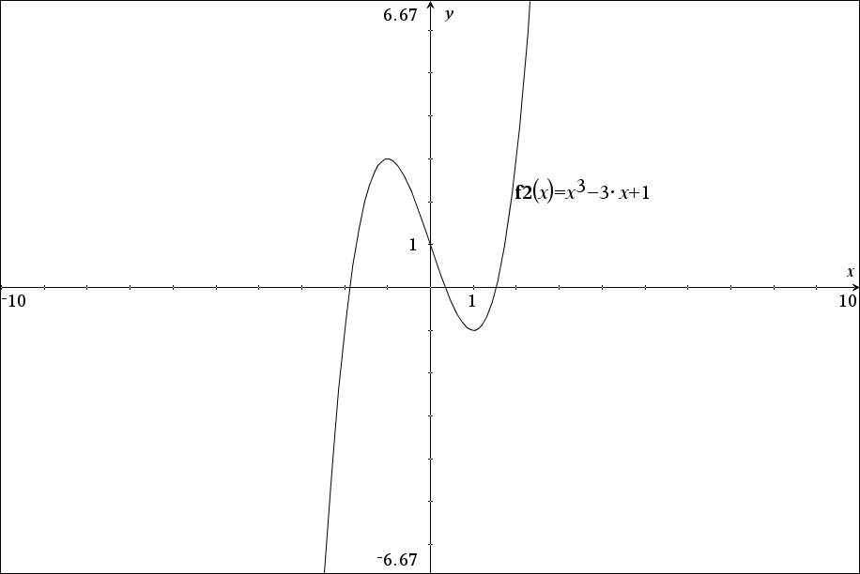
Two examples showing CAS imperfections – second example

Slide 13
Two examples showing CAS imperfections – second example
Again, let’s compare the solutions we obtain when we solve the equation
$$f_{2}\left(x\right)=x^{3}−3x+1=0$$
using 4 different CAS:
MapleTM,
MathematicaTM,
TI-NspireTM and
DeriveTM.

Slide 14
Two examples showing CAS imperfections – second example
With MapleTM (it’s hard to believe these are real values)
$$\frac{1}{2}{\left(−4+4\text{I}\sqrt{3}\right)}^{1/3}+\frac{2}{{\left(−4+4\text{I}\sqrt{3}\right)}^{1/3}}$$
$$−\frac{1}{4}{\left(−4+4\text{I}\sqrt{3}\right)}^{1/3}−\frac{1}{{\left(−4+4\text{I}\sqrt{3}\right)}^{1/3}}+\frac{1}{2}\text{I}\sqrt{3}\left(\frac{1}{2}{\left(−4+4\text{I}\sqrt{3}\right)}^{1/3}−\frac{2}{{\left(−4+4\text{I}\sqrt{3}\right)}^{1/3}}\right)$$
$$−\frac{1}{4}{\left(−4+4\text{I}\sqrt{3}\right)}^{1/3}−\frac{1}{{\left(−4+4\text{I}\sqrt{3}\right)}^{1/3}}−\frac{1}{2}\text{I}\sqrt{3}\left(\frac{1}{2}{\left(−4+4\text{I}\sqrt{3}\right)}^{1/3}−\frac{2}{{\left(−4+4\text{I}\sqrt{3}\right)}^{1/3}}\right)$$

Slide 15
Two examples showing CAS imperfections – second example
With MathematicaTM:
$$\frac{1}{{\left(\frac{1}{2}\left(−1+\text{i}\sqrt{3}\right)\right)}^{1/3}}+{\left(\frac{1}{2}\left(−1+\text{i}\sqrt{3}\right)\right)}^{1/3}$$
$$−\frac{1−\text{i}\sqrt{3}}{2^{2/3}{\left(−1+\text{i}\sqrt{3}\right)}^{1/3}}−\frac{1}{2}{\left(\frac{1}{2}\left(−1+\text{i}\sqrt{3}\right)\right)}^{1/3}\left(1+\text{i}\sqrt{3}\right)$$
$$−\frac{1}{2}\left(1−\text{i}\sqrt{3}\right){\left(\frac{1}{2}\left(−1+\text{i}\sqrt{3}\right)\right)}^{1/3}−\frac{1+\text{i}\sqrt{3}}{2^{2/3}{\left(−1+\text{i}\sqrt{3}\right)}^{1/3}}$$

Slide 16
Two examples showing CAS imperfections – second example
With TI-NspireTM :
$$−\left(\cos\left(\frac{2∙π}{9}\right)+\sin\left(\frac{2∙π}{9}\right)∙\sqrt{3}\right)$$
$$\frac{1}{\cos\left(\frac{2∙π}{9}\right)+\sin\left(\frac{2∙π}{9}\right)∙\sqrt{3}+1}$$
$$\frac{\cos\left(\frac{2∙π}{9}\right)+\sin\left(\frac{2∙π}{9}\right)∙\sqrt{3}+1}{\cos\left(\frac{2∙π}{9}\right)+\sin\left(\frac{2∙π}{9}\right)∙\sqrt{3}}$$

Slide 17
Two examples showing CAS imperfections – second example
With DeriveTM (again, so much simpler):
$$2∙\cos\left(\frac{2π}{9}\right)$$
$$−2∙\cos\left(\frac{π}{9}\right)$$
$$2∙\sin\left(\frac{π}{18}\right)$$

Slide 18
An algorithm to beautify the solutions
Our goal is to create a new function for TI-Nspire that finds the roots of a third degree polynomial function while:
avoiding the presence of radicals in the denominators of the roots;
avoiding needless occurrence of $\text{i}$ in the real roots and using, instead, trig expressions for the roots;
The next slides present the algorithm we will implement.

Slide 19
An algorithm to beautify the solutions
This new function has been implemented by Michel Beaudin and can be downloaded. Go to
https://cours.etsmtl.ca/seg/mbeaudin/
And save the TI-Nspire CX CAS library “Kit_ETS_MB” into MyLib. The name of the function is “compact_cubic”.
This function DOES NOT overwrite TI “zeros” function. It should be used when “simple answers” is what a user wants.

Slide 20
An algorithm to beautify the solutions
For example, this function yields answers similar to the ones Derive gives:

Slide 21
An algorithm to beautify the solutions
Here is how we will proceed.
First, we will show that ${ax}^{3}+{bx}^{2}+cx+d$ can be transformed into
$y^{3}$ $+$ 3 $py$ $−$ 2$q$
where $p$, $q$ depend on $a$, $b$, $c$and $d$. Of course, we may assume both $p, q$ different from 0.
Then the sign of $p^{3}+q^{2}$ will be very important.

Slide 22
An algorithm to beautify the solutions
When $p^{3}+q^{2}$ > 0, we will obtain the Cardano’s formula: one of the 3 roots of $y^{3}$ $+$ 3 $py$ $−$ 2$q$ = 0 will be
$$y={\left(q+\sqrt{p^{3}+q^{2}}\right)}^{1/3}−\frac{p}{{\left(q+\sqrt{p^{3}+q^{2}}\right)}^{1/3}}$$
Here ${\left(q+\sqrt{p^{3}+q^{2}}\right)}^{1/3}$ stands for one of the 3 cubic roots of $q+\sqrt{p^{3}+q^{2}}$.

Slide 23
An algorithm to beautify the solutions
When $p^{3}+q^{2}$ < 0, we will obtain trigonometric solutions (Viète’s formulas).
The 3 (distinct) solutions of $y^{3}$ $+$ 3 $py$ $−$ 2$q$ = 0 are given by
$y$= 2$\sqrt{−p}$ sin(θ )
where −π/2 < θ < π/2 and where θ can be found by solving sin(3θ ) = $\frac{q}{p\sqrt{−p}}$ on the interval −π/2 < θ < π/2.
Note: if $p^{3}+q^{2}$ = 0 , we will show we have a double root.

Slide 24
Using TI-Nspire CX CAS
How to create this new function is best illustrated with a live example.
The ease of use of Nspire will enable us to do live mathematics on the computer.
Let’s move to Nspire.

Slide 25
Conclusion
Teaching mathematics using CAS is, as far as we are concerned, an excellent opportunity for mathematics teachers to stay enthusiastic even though the curriculum has been quite the same for the several past years!
Last but not least: using computer algebra system gives you the freedom to explore different approaches to problems ─ approaches that you probably would not even consider if you had to do the calculations by hand. (Derive User Manual).

